Slide 1


BIT07 – Machine Learning
Cedric Hermans

Slide 2
Machine Learning
Hyperparameter tuning

Slide 3
Hyperparameters
A parameter that is set before the learning process begins
Tunable
Can directly affect how well a model trains

Slide 4
Hyperparameters
Examples:
α
C
Penalty (L1 or L2)
Solver (= kernel)
(future)
Learning rate
Number of epochs
Number of branches in decision trees
Number of clusters (E.g. K-means clustering)

Slide 5
Automate optimal hyperparameters
Strategies:
Grid Search
Random Search
Bayesian Optimization
Gradient-Based Optimization
Evolutionary Optimization
…

Slide 6
Automate optimal hyperparameters
Grid search
Tries all possible combinations of given hyperparameters
E.g. C=[0.1, 1, 100] & penalty=[‘L1’,’L2’] will try:
C=0.1 & penalty=‘L1’
C=1 & penalty=‘L1’
C=100 & penalty=‘L1’
C=0.1 & penalty=‘L2’
C=1 & penalty=‘L2’
C=100 & penalty=‘L2’

Slide 7
Automate optimal hyperparameters
Grid search
Imagine:
parameters = [ {'kernel': ['linear'], 'C': np.linspace(0.01,20,10)},
{'kernel': ['rbf'], 'C': np.linspace(0.01,20,10),
'gamma': [0.0001, 0.001, 0.01, 0.1, 0.2]},
{'kernel': ['poly'], 'C':np.linspace(0.01,20,10)} ]
10 possibilities
10 * 5 possibilities
70 possibilities
10 possibilities

Slide 8
Automate optimal hyperparameters
Problem:
Same training set used for all parameters: optimization for this training set
Overfitting on training set
Solution:
Cross-validation (CV)

Slide 9
Automate optimal hyperparameters
Cross validation
Split training data in “K” folds => K-fold cross validation
Train the model K times on different subsets of the data
Note: testing data is always kept apart (not used for training)

Slide 10
Automate optimal hyperparameters
Cross validation
Example: train-test split: 0,8-0,2
K-folds: 4
Data:

Slide 11
Automate optimal hyperparameters
Cross validation
Example: train-test split: 0,8-0,2
K-folds: 4
Test data:
Training data:

Slide 12
Automate optimal hyperparameters
Cross validation
Example: train-test split: 0,8-0,2
K-folds: 4
Test data:
Fold 1:
Test
Train

Slide 13
Automate optimal hyperparameters
Cross validation
Example: train-test split: 0,8-0,2
K-folds: 4
Test data:
Fold 2:
Train
Test
Train

Slide 14
Automate optimal hyperparameters
Cross validation
Example: train-test split: 0,8-0,2
K-folds: 4
Test data:
Fold 3:
Train
Test
Train

Slide 15
Automate optimal hyperparameters
Cross validation
Example: train-test split: 0,8-0,2
K-folds: 4
Test data:
Fold 4:
Train
Test

Slide 16
Automate optimal hyperparameters
Cross-validation
Imagine (4-folds):
parameters = [ {'kernel': ['linear'], 'C': np.linspace(0.01,20,10)},
{'kernel': ['rbf'], 'C': np.linspace(0.01,20,10),
'gamma': [0.0001, 0.001, 0.01, 0.1, 0.2]},
{'kernel': ['poly'], 'C':np.linspace(0.01,20,10)} ]
10 possibilities
10 * 5 possibilities
10 possibilities
70 possibilities * 4 folds = 280 models to train

Slide 17
Automate optimal hyperparameters
Cross-validation
More folds: less bias, but larger variance (might lead to overfitting)
Fewer folds: similar behavior as just using train and test split
Ideally (depending on data): 5-10 folds

Slide 18
Automate optimal hyperparameters
Random search
Will try “n” models with random hyperparameters
E.g. 20 models with parameters:
parameters = {'solver': ['lbfgs','liblinear'],
'C': uniform(0.01, 20),
'penalty': ['L1','L2’]}
Will generate 20 random models that will randomly have a lbfgs or liblinear kernel and have C values between 0.01 and 20 and a random penalty
Note: due to randomness, most of the tested models could have for example C values that are close together. More models => lower chance of this happening

Slide 19
Automate optimal hyperparameters
Bayes optimization
Based on Bayes Theorem (See 3. Naive Bayes)
Direct a search that is efficient and effective
Probabilistic model of the objective function
Starts as a random search and will perform extra optimization

Slide 20
Automate optimal hyperparameters
Bayes optimization
E.g. start with 4 random models based on hyperparameters
Based on probabilities: try new values
Score
Hyperparameter

Slide 21
Automate optimal hyperparameters
Bayes optimization
Note: this is very much simplified. It happens a bit different in reality
Score
Hyperparameter

Slide 22
Automate optimal hyperparameters
Bayes optimization
Based on probabilistic model: choose a new point
Based on probabilities: choose value
=> The new hyperparameter value to test
Score
Hyperparameter

Slide 23
Automate optimal hyperparameters
Bayes optimization
Update the model
Score
Hyperparameter

Slide 24
Automate optimal hyperparameters
Bayes optimization
Repeat n-times
Score
New hyperparameter to test
Hyperparameter

Slide 25
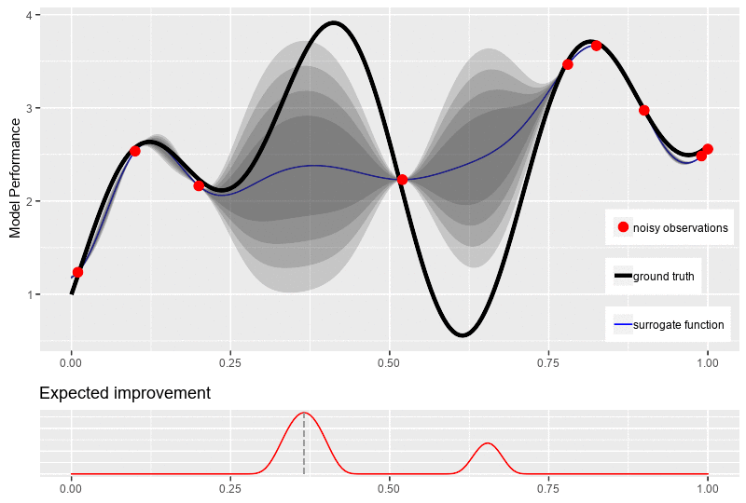
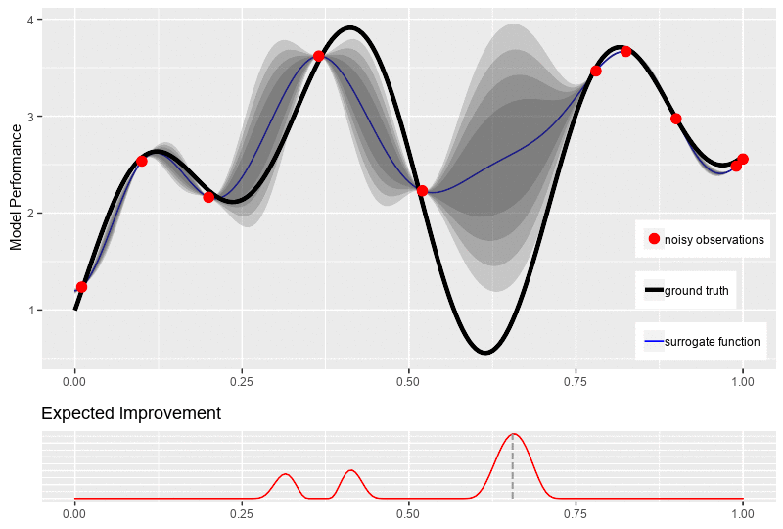
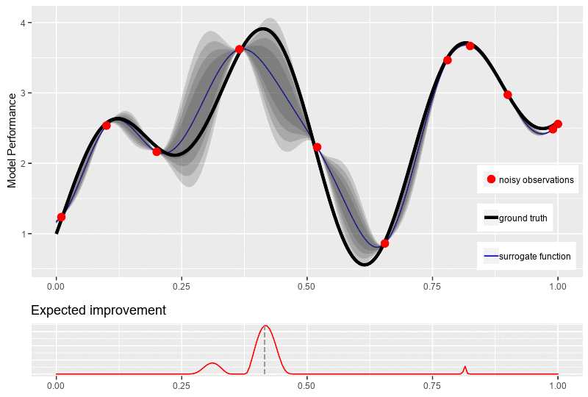
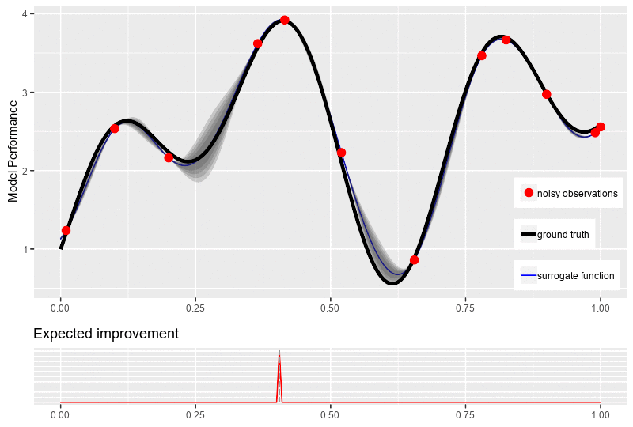
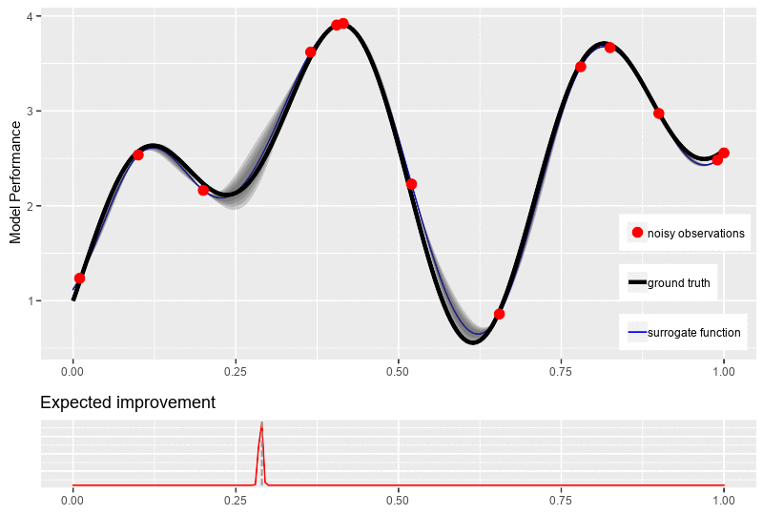
Automate optimal hyperparameters
Bayes optimization

Slide 26
Sklearn
GridSearchCV
All parameters for linear regression
Settings for GridSearchCV
from sklearn.model_selection import GridSearchCV
# Create a model (empty, however you can specify parameters if you want)
LRmodel = LinearRegression()
# Parameters to test:
# A list of one or more dictionaries
# For each dictionary, all combinations are tested
# Multiple dictionaries: for each dictionary, all combinations
# in that dictionary are tested (no combinations across different dictionaries)
parameters = [{'penalty':['l1','l2'],
'C': np.linspace(0.01,20,10)}]
grid_search = GridSearchCV(estimator=LRmodel,
param_grid=parameters,
scoring='accuracy',
cv=5, #Number of folds
n_jobs=-1, #How many threads to use (-1=all)
verbose=5) #How much information to show

Slide 27
Sklearn
GridSearchCV
All parameters for linear regression
Settings for GridSearchCV
grid_search = grid_search.fit(X_train, y_train)
# Get the best score and model settings
best_accuracy = grid_search.best_score_
best_parameters = grid_search.best_params_
# grid_search now also contains the best model
# we can use this immediately to test our test set
# classification_report: shows all interesting metrics in one
from sklearn.metrics import classification_report
y_pred = grid_search.predict(X_test)
print(classification_report(y_test, y_pred))

Slide 28
Sklearn
RandomizedSearchCV
All parameters for linear regression
Settings for RandomizedSearchCV
from sklearn.model_selection import RandomizedSearchCV
# distributions
from scipy.stats import uniform
parameters = [{'penalty':['l1','l2'],
'C': uniform(0.01,20)}]
# Amount of random parameters to test (Note: not yet xK folds)
n_iter_search = 20
random_search = RandomizedSearchCV(estimator=model,
param_distributions=parameters,
cv=5, #20 iterations * 5 K-folds = 100 models
n_iter=n_iter_search,
n_jobs = -1,
verbose=5)

Slide 29
Sklearn
BayesSearchCV
All parameters for linear regression
Settings for BayesSearchCV
#Bayessearch cv uit Scikit-optimize
from skopt import BayesSearchCV #scikit-optimize: pip install scikit-optimize
from skopt.space import Real, Categorical, Integer
parameters = [{'penalty':Categorical(['l1','l2']),
'C': Real(0.01,20,prior='uniform')}]
# Amount of random parameters to test before optimizing (Note: not yet xK folds)
n_iter_search = 20
random_search = BayesSearchCV(estimator=model,
search_spaces=parameters,
cv=5,
n_iter=n_iter_search,
n_jobs = -1,
verbose=5)

